Slide 1



McGill
Students’
Trading Society
PYTHON FOR FINANCE
tradingsociety.wixsite.com/msts

Slide 2
AGENDA
WHAT WILL YOU LEARN?
1. PORTFOLIO THEORY BASICS
4. IMPORTANT LIBRARIES : NUMPY, PANDAS, MATPLOTLIB
5. ALGORITHMS IN TRADING, PORTFOLIO MANAGEMENT AND MORE
7. INTERVIEW QUESTIONSCLOSING REMARKS
6. LIVE DEMO WORKING IN THE JUPYTER ENVIRONMENT
2. WHAT IS PYTHON?: UNDERSTANDING PROGRAMMING
3. API'S : APPLICATION PROGRAMMING INTERFACE

Slide 3

CODING FOR FINANCE
SETTING UP IN PYTHON

Slide 4


MSTS CODING FOR FINANCE
SETTING UP – HOW TO GET STARTED
A Programming Language
Python 3 will be the programming language we code in
Python is nothing but a bunch of pieces of code that can be downloaded on your computer
A Place to Code (An IDE)
Python code can be written and interpreted using some form of text editor
We will use Anaconda, which allows us to work with features in an integrated environment
Patience, Will, and Persistence
Learning Python takes time and can be challenging at times
Enjoy the process of learning a valuable skill and embrace its complexity
Notes:
Check if people have python installed by going into the terminal and typing python

Slide 5


MSTS CODING FOR FINANCE
UNDERSTANDING PYTHON
The Language
Python is a widely used multi-purpose programming language recommended for beginner programmers looking to learn how to code as it is highly intuitive and easy to use. There are many other programming languages including C++, Java etc. which offer different advantages but Python is the closest you can get to a pseudo-code programming language.
Libraries
Libraries are long pieces of code that can be imported and used by programmers to execute certain functions within their own program. For Finance, important libraries include NumPy for numerical computation, Pandas for data collection and analysis, and Matplotlib for data visualization.
Notes:
Check if people have python installed by going into the terminal and typing python

Slide 6
MSTS CODING FOR FINANCE
PYTHON KEY ELEMENTS
Keywords
Assignments
Data Types
Functions
Special words that may not be used for any other purpose:
False
True
Import
If
Else
For
While
Return
In
Instructions that python interpreter can execute:
Assignment: x = 2
If statement: if this / do that
For statement: for this / do that
While statement: while this/ do that
Values have data types; classes with methods:
Numbers: int/ float/ complex
List: [1,2,3]
Tuple: (“hi”, “hello”)
Strings: “hello”
Functions used to combine code and create things:
Def my function
Print )”I created a function”)
Return
Notes:
https://www.programiz.com/python-programming/statement-indentation-comments

Slide 7
MSTS CODING FOR FINANCE
APIs – APPLICATION PROGRAMMING INTERFACE
What is an API?
APIs are software intermediaries that allow two applications to talk to each other. For our purposes, we will use the API’s of numpy, matplotlib and pandas, as well as API’s of exchanges or simply API’s made for data distribution.
How to think about an API
You can think of an API as the link between your order and the kitchen. The waiter takes your message to the kitchen and your kitchen delivers your order. We will be doing the same thing to access data, asking an API for certain information and the API will return data. API’s can also be used to communicate with exchanges, if we want to pass an order for example, we will use a predefined function, part of the exchanges’ API, to pass that order.
Notes:
Imagine you’re sitting at a table in a restaurant with a menu of choices to order from. The kitchen is the part of the “system” that will prepare your order. What is missing is the critical link to communicate your order to the kitchen and deliver your food back to your table. That’s where the waiter or API comes in. The waiter is the messenger – or API – that takes your request or order and tells the kitchen – the system – what to do. Then the waiter delivers the response back to you; in this case, it is the food.

Slide 8
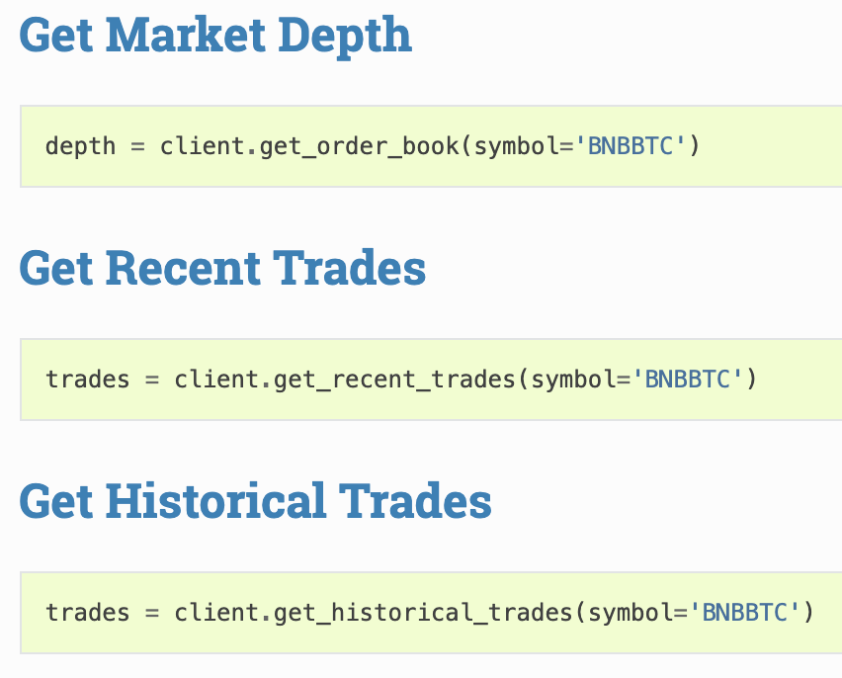
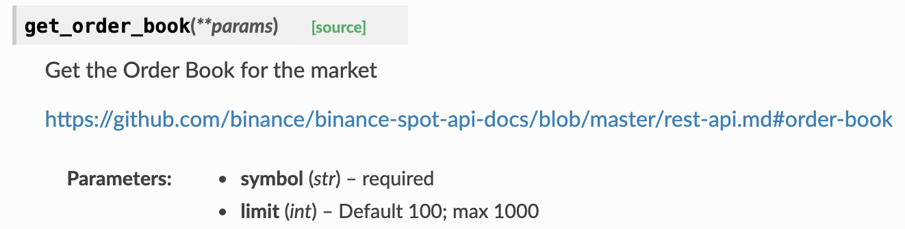
MSTS CODING FOR FINANCE
APIs – APPLICATION PROGRAMMING INTERFACE
What does an API look like?
Notes:
Imagine you’re sitting at a table in a restaurant with a menu of choices to order from. The kitchen is the part of the “system” that will prepare your order. What is missing is the critical link to communicate your order to the kitchen and deliver your food back to your table. That’s where the waiter or API comes in. The waiter is the messenger – or API – that takes your request or order and tells the kitchen – the system – what to do. Then the waiter delivers the response back to you; in this case, it is the food.

Slide 9

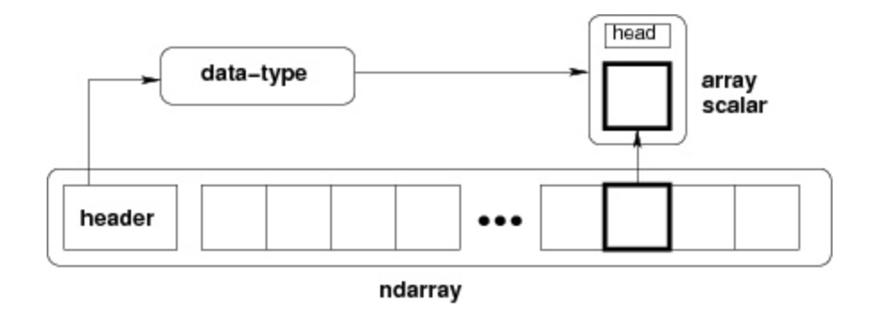
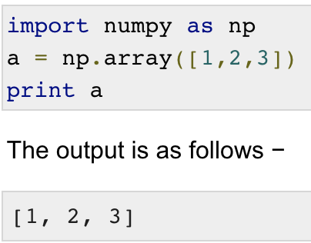
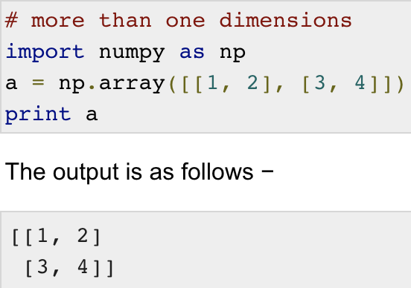
MSTS CODING FOR FINANCE
NUMERICAL PYTHON: NUMPY LIBRARY
Numerical Python, also known as numpy is a powerful python package
The library consists of multi-dimensional array objects and allows for fast computation
It is used for mathematical and logical operations on arrays and data frames
It is used for operations related to linear algebra and random number generation
Notes:
The most important object defined in NumPy is an N-dimensional array type called ndarray. It describes the collection of items of the same type. Items in the collection can be accessed using a zero-based index.
Make sure everyone pip installs numpy – requirement is already satisfied
Numerical Python: Numpy Library

Slide 10

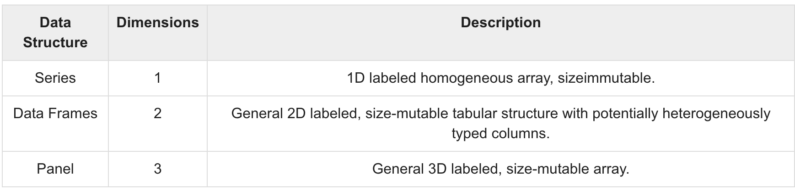
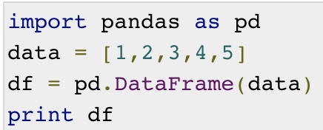
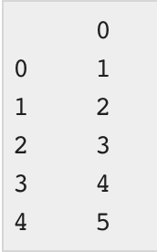
MSTS CODING FOR FINANCE
PANDAS LIBRARY
Pandas is a python library providing easy to use data structures and data analysis tools
It is used for fast data frame object and customizable indexing
It uses tools to load data into in-memory data objects from different files formats (csv, etc.)
It is used for merging, joining labeling, indexing, slicing large sets of data
Notes:
pip install pandas

Slide 11

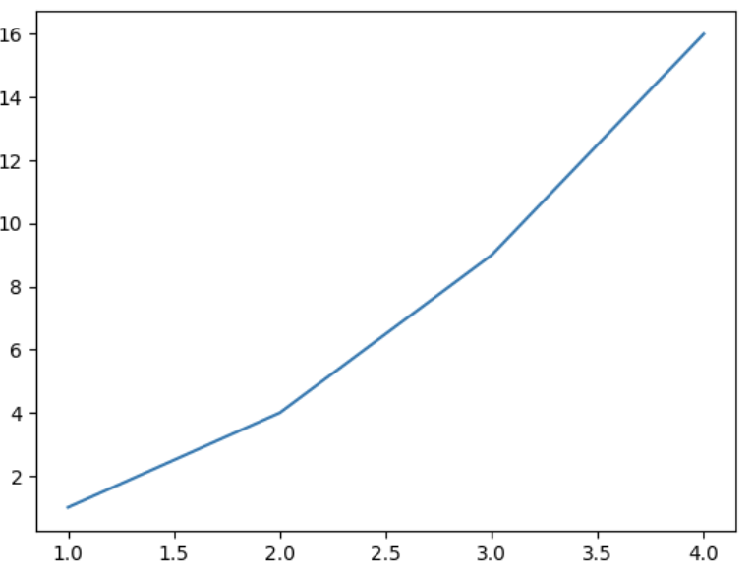
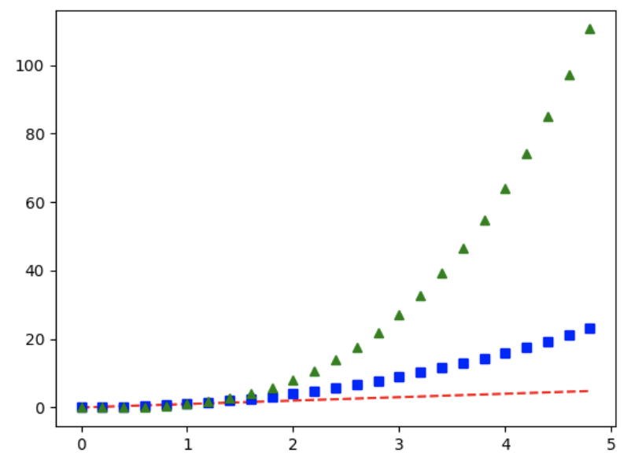
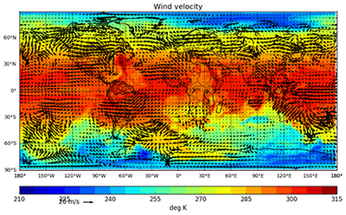
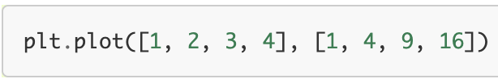
MSTS CODING FOR FINANCE
MATPLOTLIB LIBRARY
It is recognized as an extremely powerful visualization tool in data science and data analysis
It used to produce publication quality figures in hardcopy formats
Application includes plots, histograms, power spectra, bar chart, error chart, scatterplots etc.
Matplotlib allows us to plot functions, generate graphs and more generally access visual representation of the data
Notes:
pip install pandas

Slide 12

MSTS CODING FOR FINANCE
JUPYTER
What is Jupyter?
Jupyter is an environment known as a web-based UI (user interface) for python
Jupyter enables one to work with code and present documents using markdown code simultaneously
The environment is extremely flexible and allows for visualization of code
What is it used for?
Writing Python Code and visualizing outputs, dynamic adjusting
Kernel backed documents to enable code in Python, R, Markdown and more into your notebook
Work with Markdown to clean up code and present your research
Notes:
pip install pandas

Slide 13

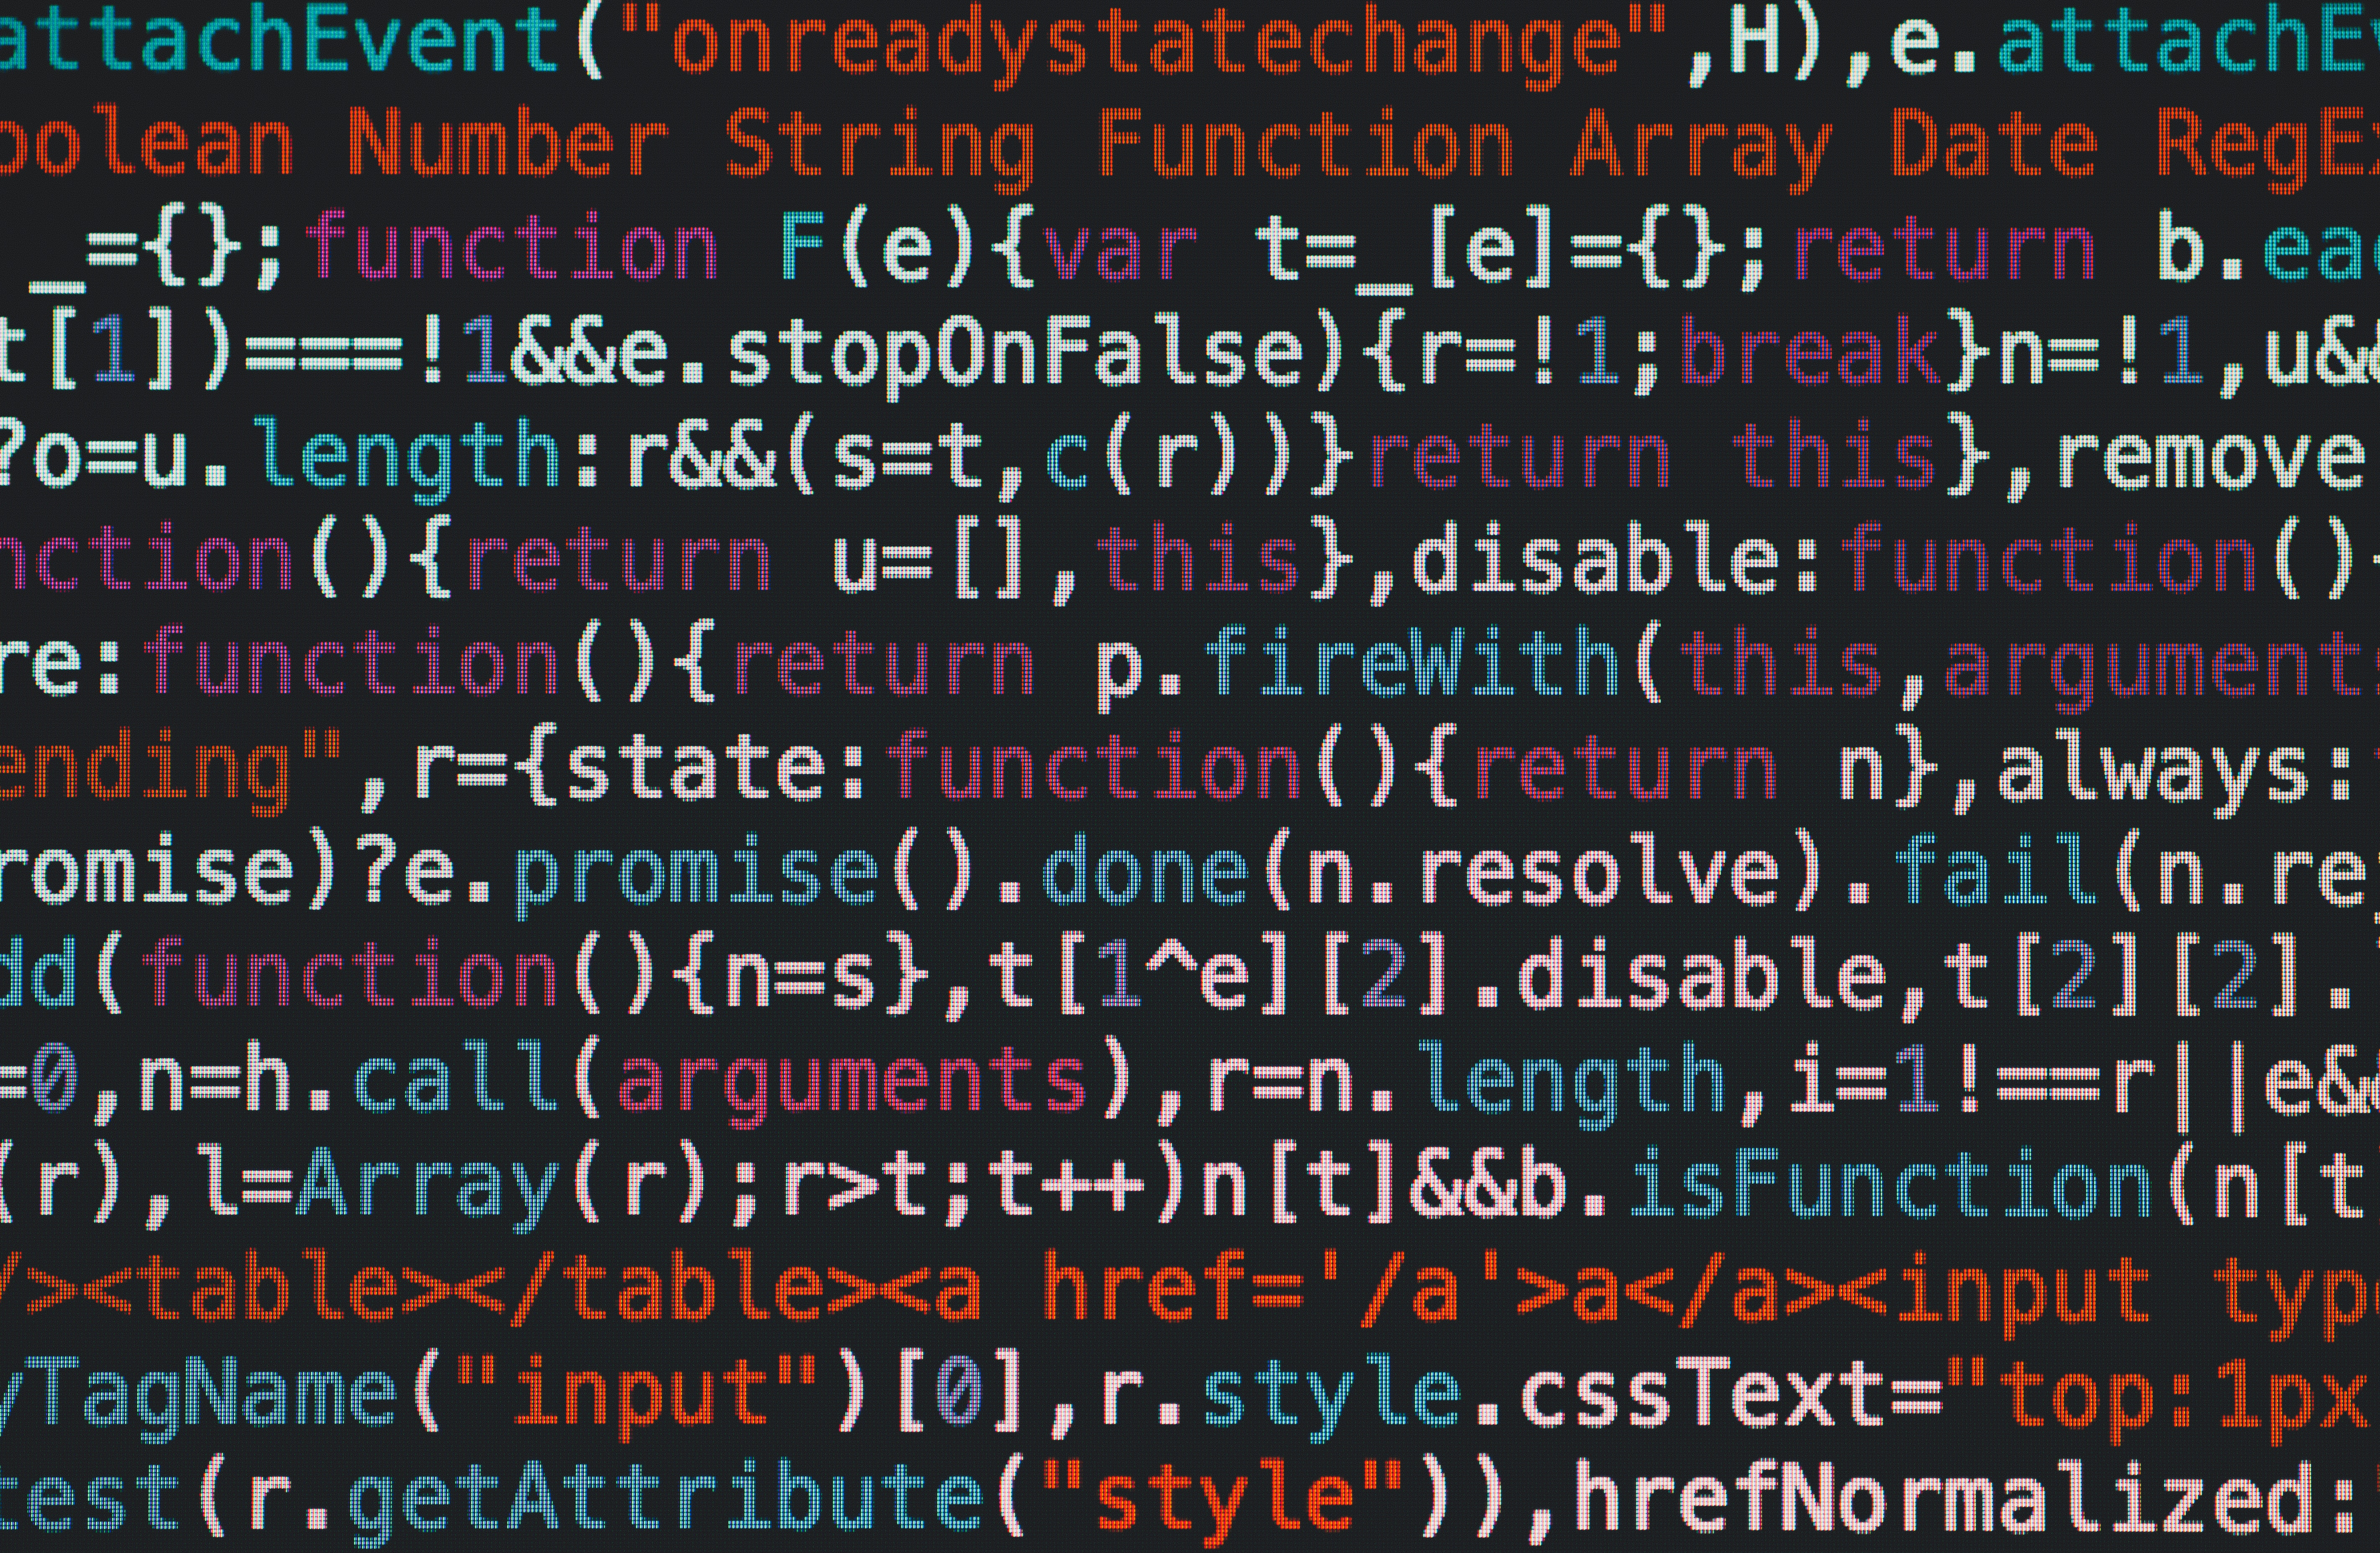

MSTS CODING FOR FINANCE
HOW CODING WORKS
APIs - Application Programming Interface
Notes:
Check if people have python installed by going into the terminal and typing python

Slide 14



LET’S GO TO JUPYTER
CODING FOR FINANCE

Slide 15
PROGRAMMING APPLICATION IN FINANCE
CODING IN FINANCE
Trading Strategies
Portfolio Creation and Optimization
Industry Practice (Pricing Securities & Derivatives)
Banks, Trading Firms, Hedge Funds barely do any of their trading manually anymore (60% of all trades placed on the market are driven by algorithms)
The most famous financial institutions have generated consistent returns using quantitative strategies and models (Renaissance Technologies, Citadel etc.)
Many Asset managers have turned to quantitative models implemented through algorithms to create dollar and market neutral portfolios, implement factor theory and more.
Mathematicians such as Edward Thorpe, D.E Shaw, Jim Simons and more have built portfolios and trading models through quantitative analysis using entire teams of developers.
Banks and Market Makers price derivative products such as options using mathematical models automated with code.
Quants on Wall Street constantly use code to create models and automate processes without which their jobs would not exist.
Notes:
pip install pandas

Slide 16
PROGRAMMING APPLICATION IN FINANCE
CS JOBS IN FINANCE
Quants
Traders
Front & Back Office
A quant or quantitative analyst are employed by investment banks, hedge funds and other financial firms
Quants are extremely valuable, and it is not uncommon to find salaries of 500K+ per year as these jobs require high levels of competency.
Up and coming are firms that trade almost entirely quantitatively. Whether it be hedge funds or prop trading firms, many now focus on aggregating large amounts of trades and using computer models to find edge.
Firms such as Citadel are hiring traders that can code in C++, Java, Python and more
Whether its managing risk, handling data or enhancing security, many roles are available to those familiar with computer science in finance. More importantly, these are bound to become more important and prevalent in the coming years
Notes:
pip install pandas

Slide 17

CAREER
INTERVIEWS

Slide 18
INTERVIEW QUESTIONS
SALES AND TRADING
Roles related to computer science in the finance industry often require creative thinking abilities and good knowledge of mathematics. We’ve chosen some fun questions to end the session
Ranked by difficulty (Low – High) of course
QUESTIONS
What is the probability of rolling two 6 faced dice and having the sum of your rolls be equal to less than three?
The chance of seeing a shooting star in 1 hour is 60%. What is the chance of seeing a star in half an hour?
There are 40 people in a room, what is the probability that there are at least two birthdays in common?
Notes:
Check if people have python installed by going into the terminal and typing python

Slide 19
THANK YOU FOR JOINING
THE MSTS TEAM

Slide 20




THANK YOU FOR PARTICIPATING
FOR MORE
Thank you for taking part in MSTS’s first workshop in its series “Python For Finance”
If you’d like to learn more about upcoming workshops or the workshop series itself, please contact tradingsociety@ssmu.ca
If you have questions on the setup including, python, anaconda, NumPy, pandas, matplotlib or questions on the content of this PowerPoint, please contact Stanislas Motte (me) at stanislas.motte@mail.mcgill.ca or find me on Facebook or LinkedIn at Stan Motte and Stanislas Motte respectively
If you’re excited for what is to come, make sure to read our emails, visit our website tradingsociety.wixsite.com/msts
Don’t forget to follow us on Instagram, Facebook, Instagram, and LinkedIn for content, updates and news regarding exclusive MSTS events and signups
Notes:
Check if people have python installed by going into the terminal and typing python

Slide 21
DISCLAIMER
The MSTS members and executives are not licensed financial advisors, registered investment advisers, or registered broker-dealers. The MSTS does not provide investment or financial advice or make investment recommendations, nor is it in the business of transacting trades. Nothing contained in this communication constitutes a solicitation, recommendation, promotion, endorsement, or offer by the MSTS team and members of any particular security, transaction, or investment. The information provided on this presentation should not be taken as legal advice or professional advice on finance or investments. Do not use the information as a substitute for professional advice from legal or certified financial planner or investment professionals. This presentation is intended for McGill University students and the information contained herein is subject to change without notice. The owner and publisher of this presentation is not liable for any inaccuracies in the information provided. MSTS is not liable for the views expressed in this presentation and the damages that may arise from the use of its content.
Notes:
Check if people have python installed by going into the terminal and typing python

